Slide 1
SCHEMATIC DESIGNING
Submitted by:
Mohammed Abdul Muqeeth C0751945
(Group #5)

Slide 2
AGENDA
Introduction to Project.
Introduction to software used.
Initializing a project.
Procedure involved in designing schematic/circuit diagram.
Interfacing RF transmitter with Arduino.
Interfacing MPU6050 (Gyroscope) with Arduino.
Interfacing ESP8266 with BeagleBone Black.
Interfacing RF Receiver with BeagleBone Black.
Interfacing LCD with BeagleBone Black.

Slide 3
INTRODUCTION TO PROJECT
Hand Gestured keyboard using Gyroscope sensor.
We are using BBB as a Master and an Arduino UNO as a Slave.
ESP8266 Wi-Fi module is being used to store the letters on cloud infrastructure.
The letters are also displayed on the LCD.

Slide 4
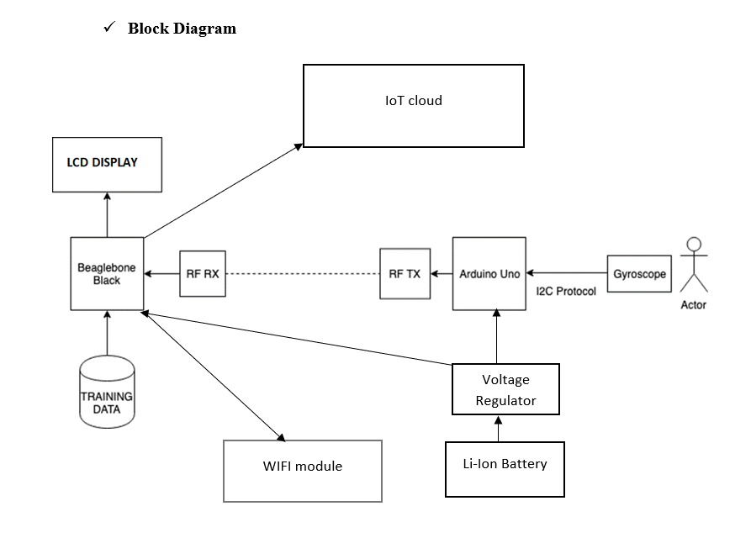
BLOCK DIAGRAM

Slide 5

INTRODUCTION TO EasyEDA
Web based tool to Design, Simulate and Share the schematics.
Allows user contribution.
Can be used to design PCB.
Has huge collection of Libraries/Components.
Features Hot key setting.
Can generate BOM.

Slide 6
INITIALIZING A PROJECT
Sign
Sign-up on http://www.easyeda.com
Click on
Click on “File” to create a new project.
Input
Input the title and short description and the save the project.
Click on
Double click on “Sheet” under project title on the left hand side to get started with designing the schematic.

Slide 7

PROCEDURE INVOLVED IN DESIGNING SCHEMATIC/CIRCUIT DIAGRAM
Once the Schematic sheet is open, select the required components from the “Library” menu on the left.
We can search and use the user contributed versions of the components as well.
All the basic components such as GND and VCC can be found in “EELib” menu.
Using the wiring tools available within the sheet, we can interconnect various components.

Slide 8
INTERFACING RF TRANSMITTER WITH ARDUINO UNO
GND pin of an RF Transmitter is connected to the virtual GND.
VCC pin of an RF Transmitter is connected to the VCC supply.
“Antenna” pin isn’t connected as we are having a short distant communication.
“DATA” pin of the RF Transmitter is connected to D11 (MOSI 8-bit PWM) pin of an Arduino.

Slide 9
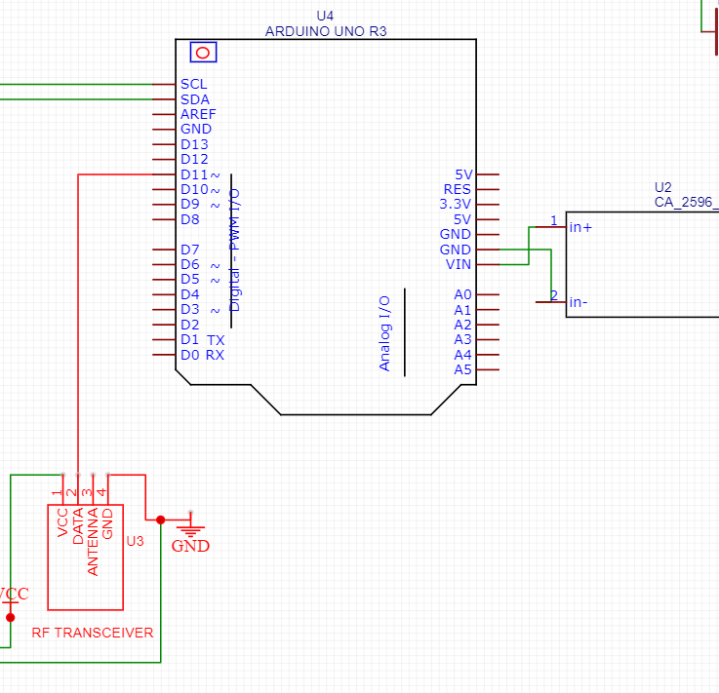
The Picture demonstrates the ARDUINO – RF Transmitter interfacing

Slide 10
INTERFACING MPU6050 (GYROSCOPE) WITH ARDUINO UNO
GND pin of a Gyroscope sensor is connected to the virtual GND.
VCC pin of a Gyroscope sensor is connected to the VCC supply.
SDA (Serial Data) and SCL (Serial Clock) pins of Gyroscope are connected to SDA(A4) and SCL(A5) pins of Arduino UNO respectively.

Slide 11
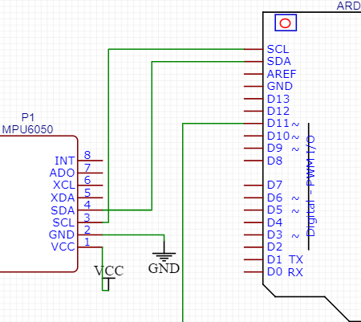
The Picture demonstrates the ARDUINO – Gyroscope interfacing

Slide 12
INTERFACING ESP8266 WITH BBB
We are using I2C protocol for this interface.
GND pin of a Gyroscope sensor is connected to the virtual GND.
VCC pin of a Gyroscope sensor is connected to the VCC supply.
RX (19) of ESP8266 is connected to P9.24 which is TX pin of BBB.
TX (18) of ESP8266 is connected to P9.26 which is RX pin of BBB.

Slide 13
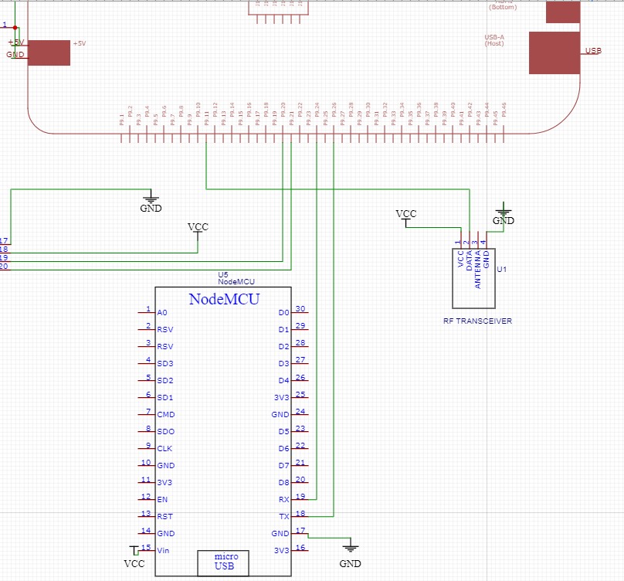
The picture demonstrates ESP8266 – BBB interfacing

Slide 14
INTERFACING LCD WITH BBB
We are using I2C protocol for LCD interfacing.
GND pin of a LCD is connected to the virtual GND.
VCC pin of a LCD is connected to the VCC supply.
SDA (19) of LCD is connected to P9.20 (I2C2_SDA) of BBB.
SCL (20) of LCD is connected to P9.21 (I2C2_SCL) of BBB.

Slide 15
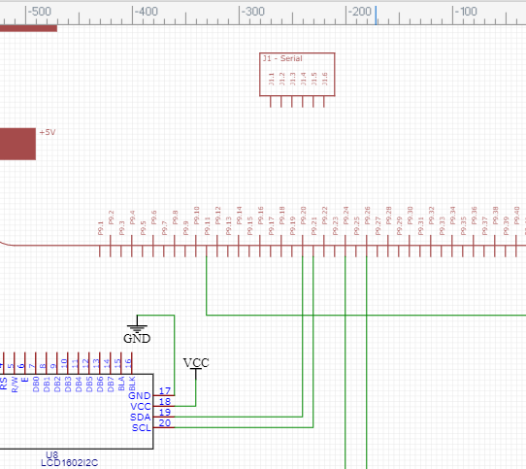
The picture demonstrates BBB – LCD interfacing

Slide 16
INTERFACING RF RECEIVER WITH BBB
GND pin of an RF Receiver is connected to the virtual GND.
VCC pin of an RF Receiver is connected to the VCC supply.
“Antenna” pin isn’t connected as we are having a short distant communication.
“DATA” pin of the RF Receiver is connected to P9.11 as an input device.

Slide 17
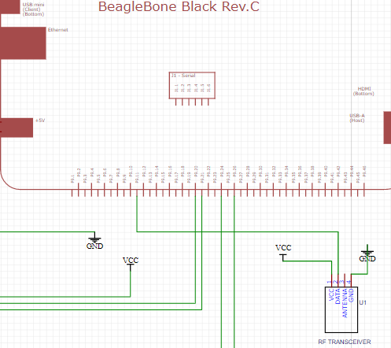
The picture demonstrates BBB – RF Receiver interfacing

Slide 18
Li-Ion BATTERY CONNECTIONS
We are using LM2596 Voltage regulator boards for constant power supply
SET 1: Vin of Arduino is connected to in+ of LM2596, GND of ARDUINO is connected to in- of LM2596 board and then Out+ of LM2596 is connected to Positive terminal of battery, Out- of LM2596 is connected to Negative terminal of battery.
SET 2: +5v of BBB is connected to in+ of LM2596, GND of BBB is connected to in- of LM2596 board and then Out+ of LM2596 is connected to Positive terminal of battery, Out- of LM2596 is connected to Negative terminal of battery.

Slide 19
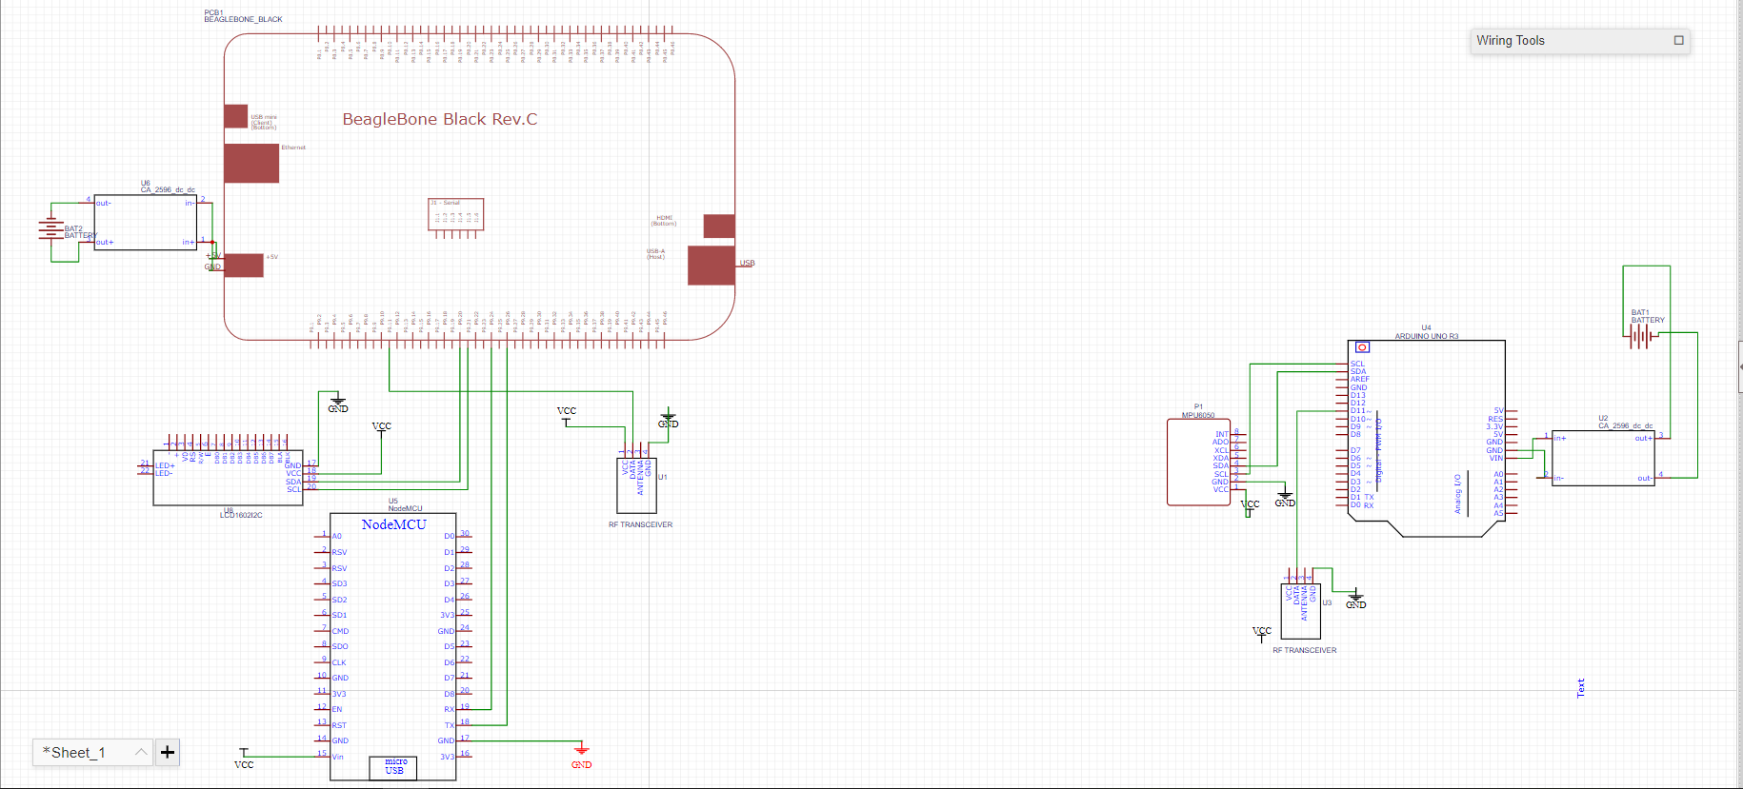
SCHEMATIC / CIRCUIT DIAGRAM

Slide 20
REFERENCES
How to Use EasyEDA to design PCB Schematic Step By Step - Circuit Board Fabrication and PCB Assembly Turnkey Services. (2020, April 19). Retrieved October 24, 2020, fromhttps://www.wellpcb.com/easyeda.html
BeagleBone Black. (n.d.). Retrieved October 24, 2020, fromhttps://components101.com/microcontrollers/beaglebone-black-pinout-datasheet
Arduino Uno. (n.d.). Retrieved October 24, 2020, from https://components101.com/microcontrollers/arduino-uno
(n.d.). Retrieved October 24, 2020, from https://forum.arduino.cc/index.php?topic=429297.15
Molloy, D. (2019). I2C. In Exploring BeagleBone: Tools and techniques for building with embedded Linux. Indiapolis: Wiley.

